Slide 1

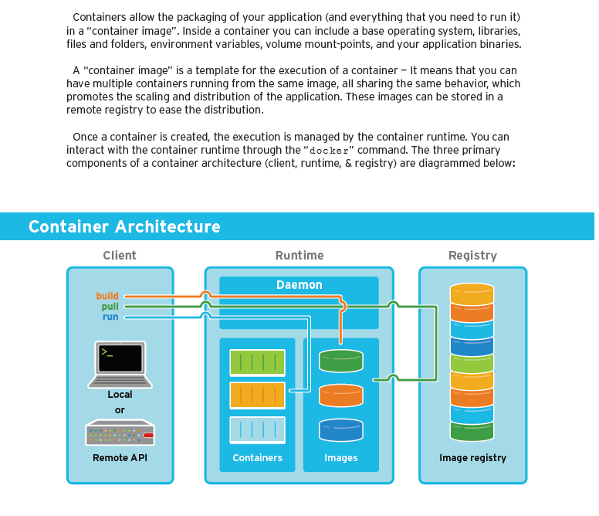
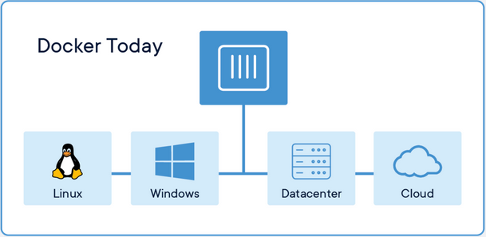
What is a Docker container ?
What to remember
A Docker container image is a lightweight, standalone, executable package of software that includes everything needed to run an application: code, runtime, system tools, system libraries and settings.
Container images become containers at runtime and in the case of Docker containers - images become containers when they run on Docker Engine. Available for both Linux and Windows-based applications, containerized software will always run the same, regardless of the infrastructure. Containers isolate software from its environment and ensure that it works uniformly despite differences for instance between development and staging.
Docker containers that run on Docker Engine:
Standard: Docker created the industry standard for containers, so they could be portable anywhere
Lightweight: Containers share the machine’s OS system kernel and therefore do not require an OS per application, driving higher server efficiencies and reducing server and licensing costs
Secure: Applications are safer in containers and Docker provides the strongest default isolation capabilities in the industry
Docker is a containerization platform widely use among dev ops and standards based

Slide 2
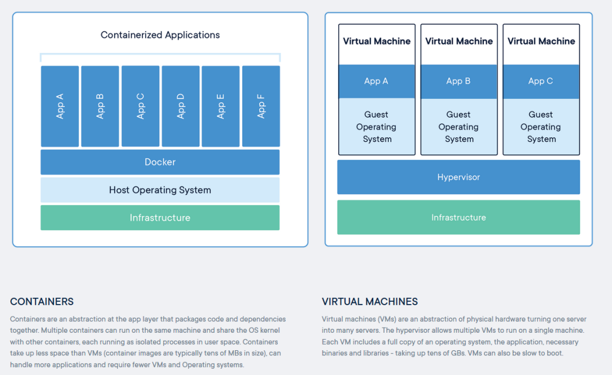
Container vs VM
What to remember
Container
Easy deployment
Simple depedndecy
Share same infrastructure
No platform specific, IDE, or programming language restrictions.
Small image sizes, making it easier to ship and store.
No compatibility issues relating to the dependencies/versions/setup.
Quick and easy application instance deployment.
Applications and their resources are isolated, leading to better modularity and security.
Host centric
VM
Split the infrastructure for each VM

Slide 3
Command line
Hyp: you have already install docker
Build
Pull
Run
https://www.aquasec.com/wiki/display/containers/Docker+Containers
Create Docker Image

